Slide 1
Austin driver capstone user interface
Created with HTML+CSS utilizing bootstrap studio

Slide 2
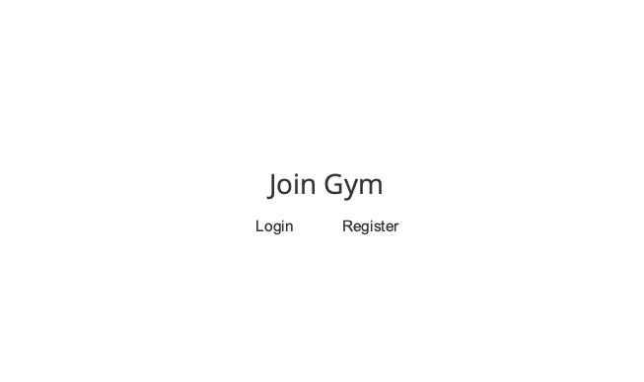
Landing Page
*Design and text bound to change

Slide 3
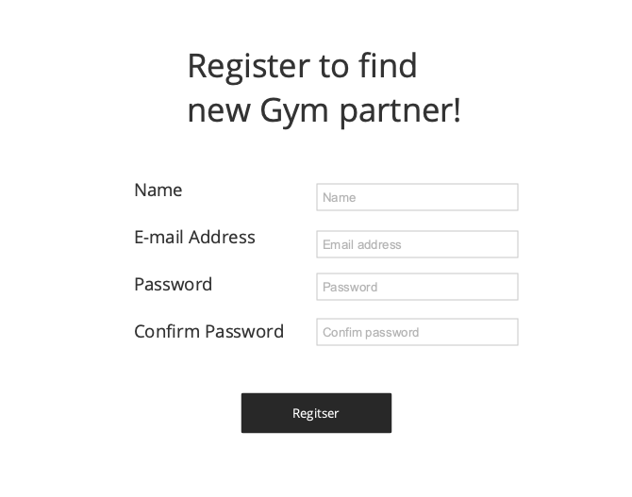
Register Page
*Design and text bound to change

Slide 4
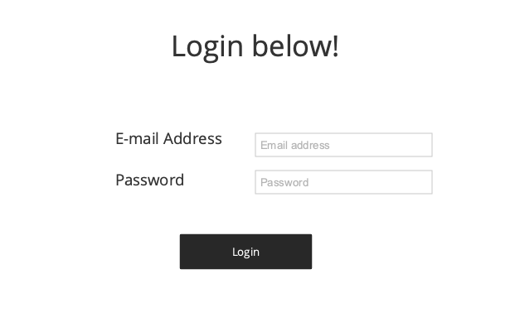
Login Page
*Design and text bound to change

Slide 5
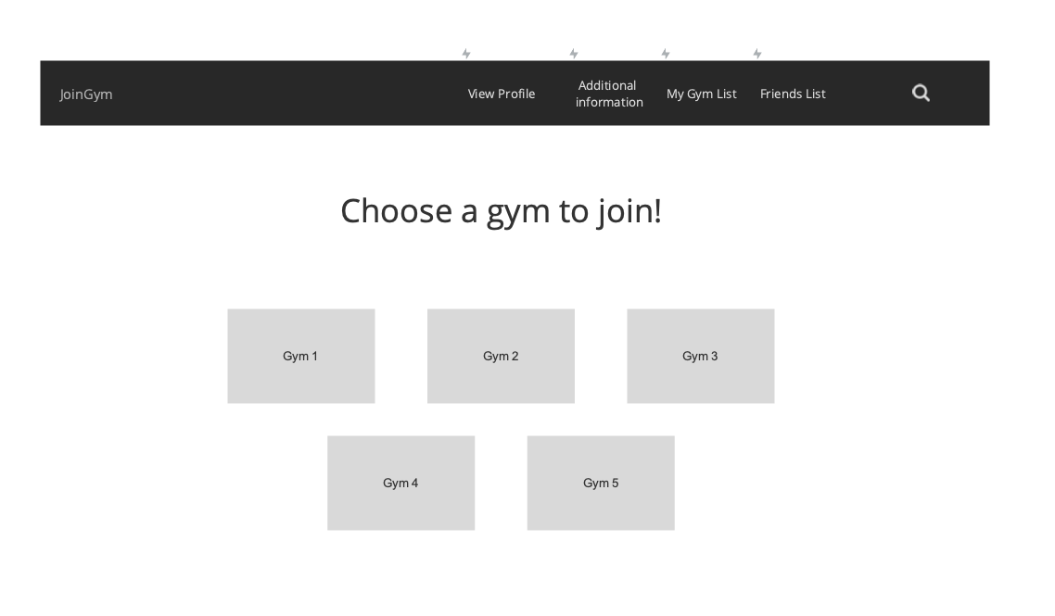
Gym list Page
*Design and text bound to change

Slide 6
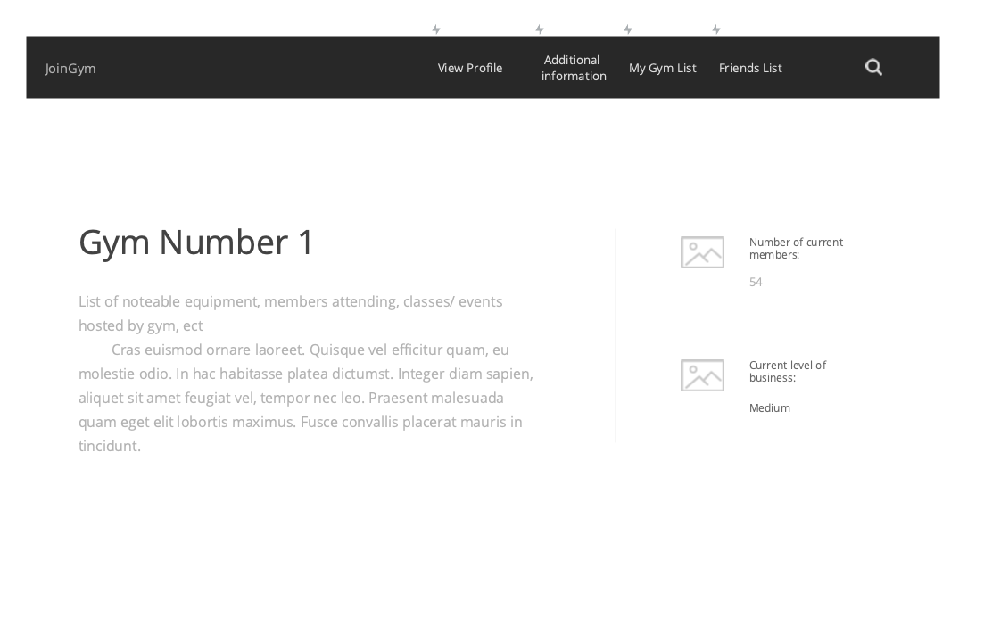
Selected Gym Page
*Design and text bound to change

Slide 7
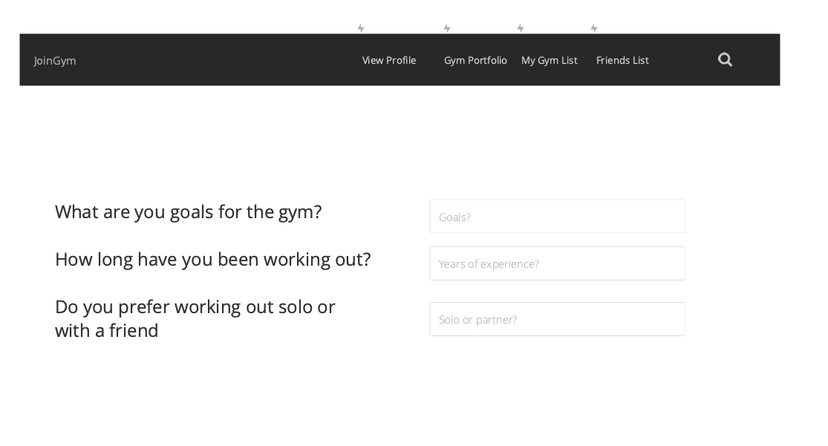
Gym Profile Page
*Design and text bound to change

Slide 8
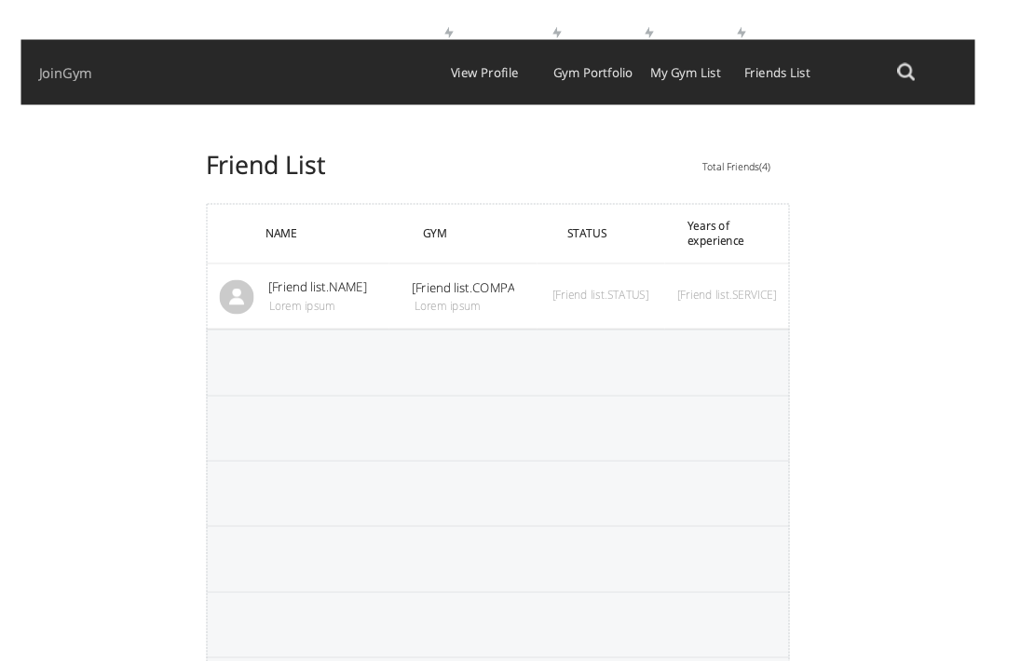
Friend List page
*Design and text bound to change

Slide 9
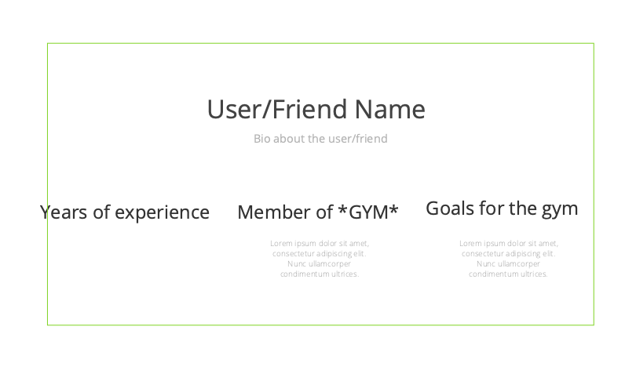
Friend Page
*Design and text bound to change

Slide 10
Admin interface
Created with HTML+CSS utilizing bootstrap studio

Slide 11
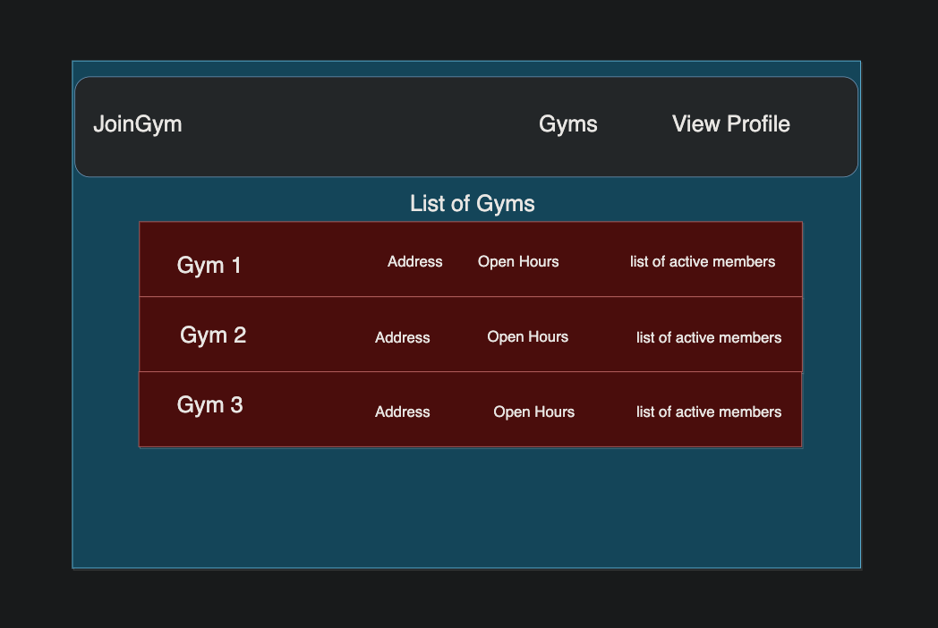
Admin Gym page
*Design and text bound to change

Slide 12
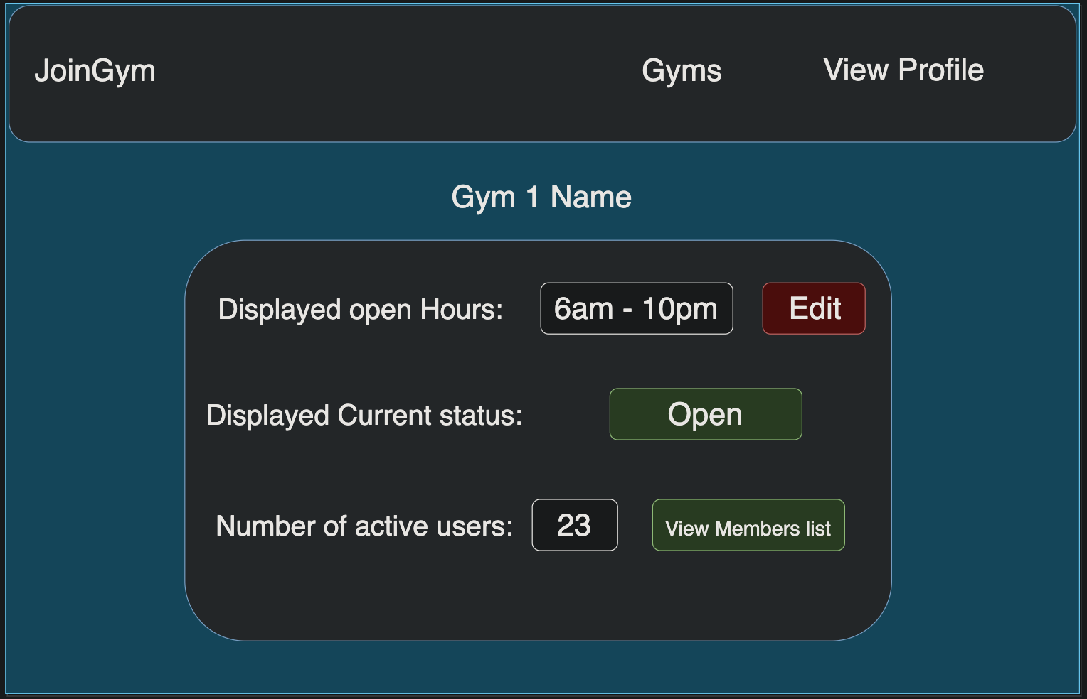
Edit Gym page
*Design and text bound to change

Slide 13
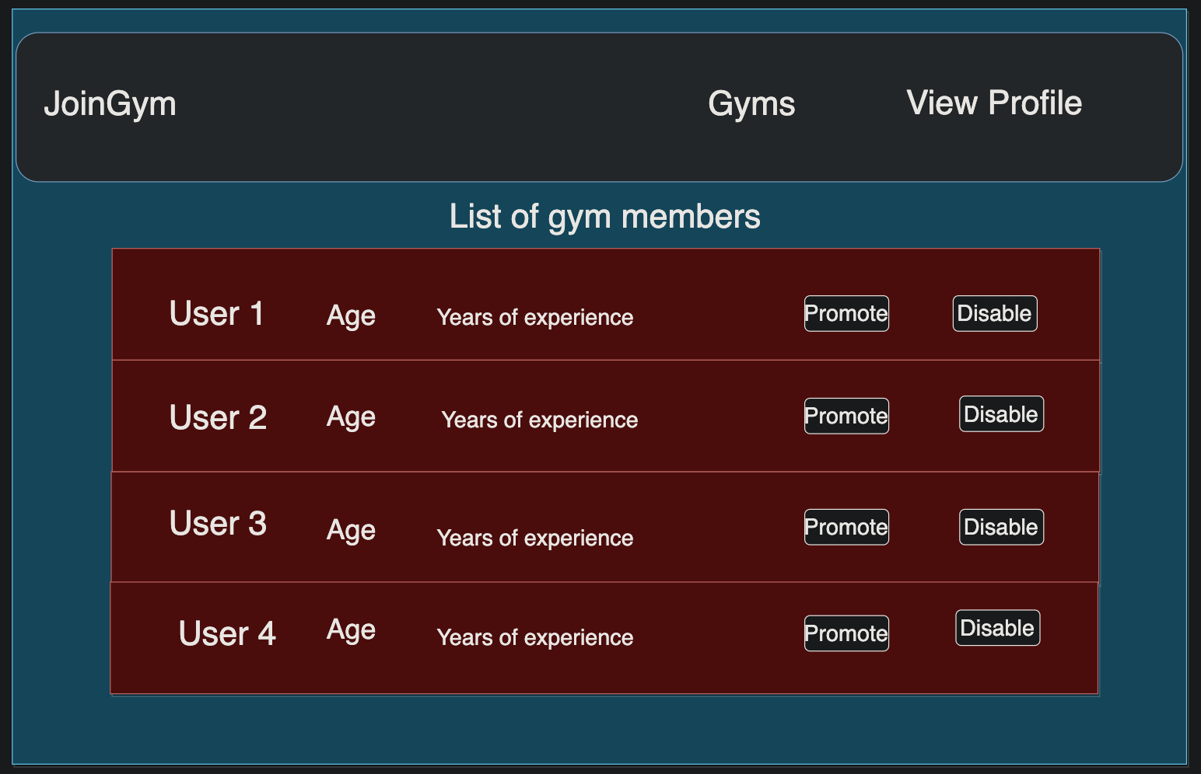
Admin User page
*Design and text bound to change

Slide 14
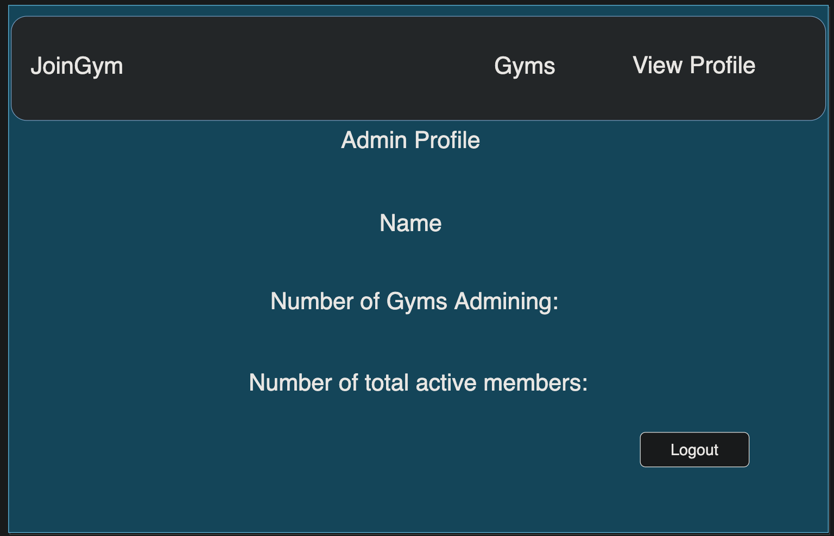
Admin Profile page
*Design and text bound to change

